Slide 1
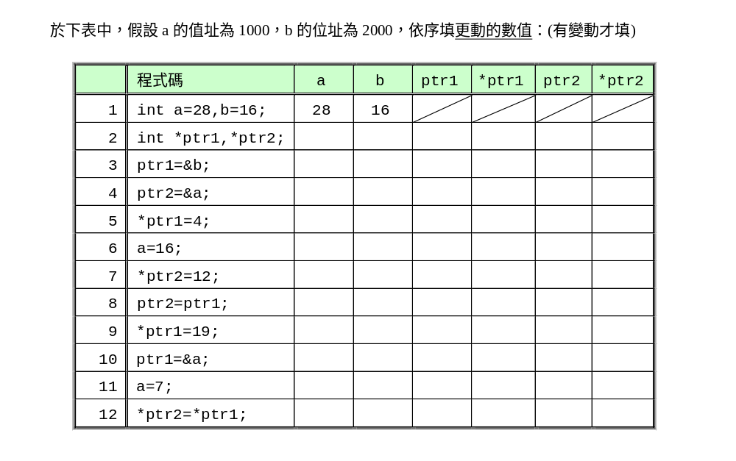
請把以下複製到WORD report，在WORD report中回答

Slide 2

1.cpp: copy a string : gets a string and copy to another string
務必用function傳陣列完成
Function: mystrcpy(char desti[], char src[])
必須用while 迴圈完成此程式 Must use ‘\0’
while(scr[i] != ‘\0’)….
    Input (parameter): two string: desti[], src[]
    Copy src[] string to desti[] : one character after another character until the end of src[]
    return: none
  Main program
    Declare 3 strings: a[], b[], c[] (size=100)
    從鍵盤讀入字串：gets() a string a[]
    1. Use mystrcpy() copy a[] to b[], print b in main()
    2. Use the C function strcpy_s() to copy a[] to c[], print c in main()

